Slide 1



Self-Consumption Of Renewable
Energy by hybrid Storage systems
SCORES project presentation
Event name
Location, date
Presenter name
Company
The project leading to this application has received funding from the European Union’s Horizon 2020 research and innovation programme under grant agreement No 766464.
This presentation reflects only the author‘s view and the European Commission is not responsible for any use that may be made of the information it contains.

Slide 2





SCORES PROJECT
SCORES combines and optimizes the multi-energy generation, storage and consumption of local renewable energy (electricity and heat) and grid supply. Via the development of compact hybrid storage technologies, integrated through a smart Building Energy Management System, the project will optimize the self-consumption in residential buildings, bring new sources of flexibility to the grid, and enable reliable operation with a positive business case in Europe’s building stock.
12 Partners
9 Work Packages
Budget €6M
48 Months
www.scores-project.eu

Slide 3
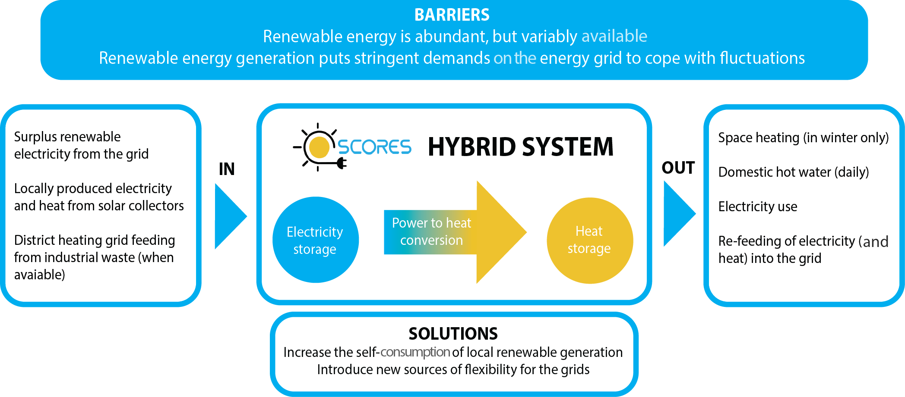
OVERALL CONCEPT
The SCORES concept is based on a hybrid system combining effectively and efficiently solutions that harvest electricity and heat from the sun, store electricity, convert electricity into heat, store heat, and manage the energy flows in the building.
www.scores-project.eu

Slide 4
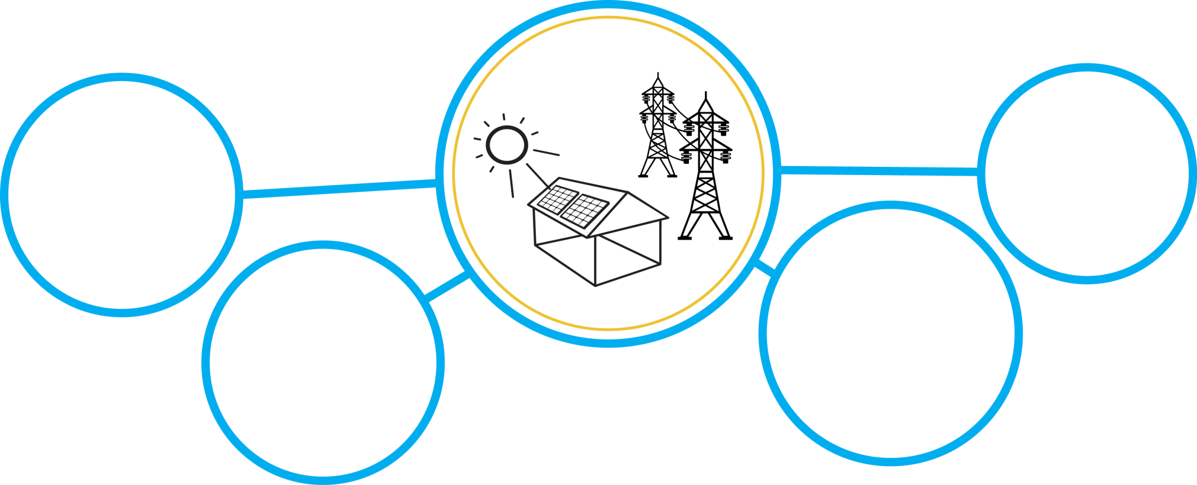
OBJECTIVES
Demonstrate in the field the integration, optimization and operation of a building energy system including new compact hybrid storage technologies, that optimize supply, storage and demand of electricity and heat in residential buildings and that increases
self-consumption of local renewable energy in residential buildings at the lowest cost.
Local level
Global level
Defer investment in the energy grids
Increase the self-consumption of local renewable generation
Introduce new sources of flexibility for the grids
Bridge the gap between supply and demand
www.scores-project.eu

Slide 5






PURPOSE
Competitive industry
Grid stability
Energy Independency
CO₂ reduction
Jobs Creation
More renewables
www.scores-project.eu

Slide 6
GOALS
1
4
2
3
Optimize a high performance water to water heat pump supplied by hybrid PV and solar collectors
6
Assess the economical potential of the hybrid system
Develop a technology of second life Li-ion batteries
Electric driven heating with intraday PCM heat storage
5
Improve and optimize compact loss free heat storage technology
Develop an integrated building energy management system
7
Efficient air to air heat pump for space heating with intraday PCM storage
www.scores-project.eu

Slide 7
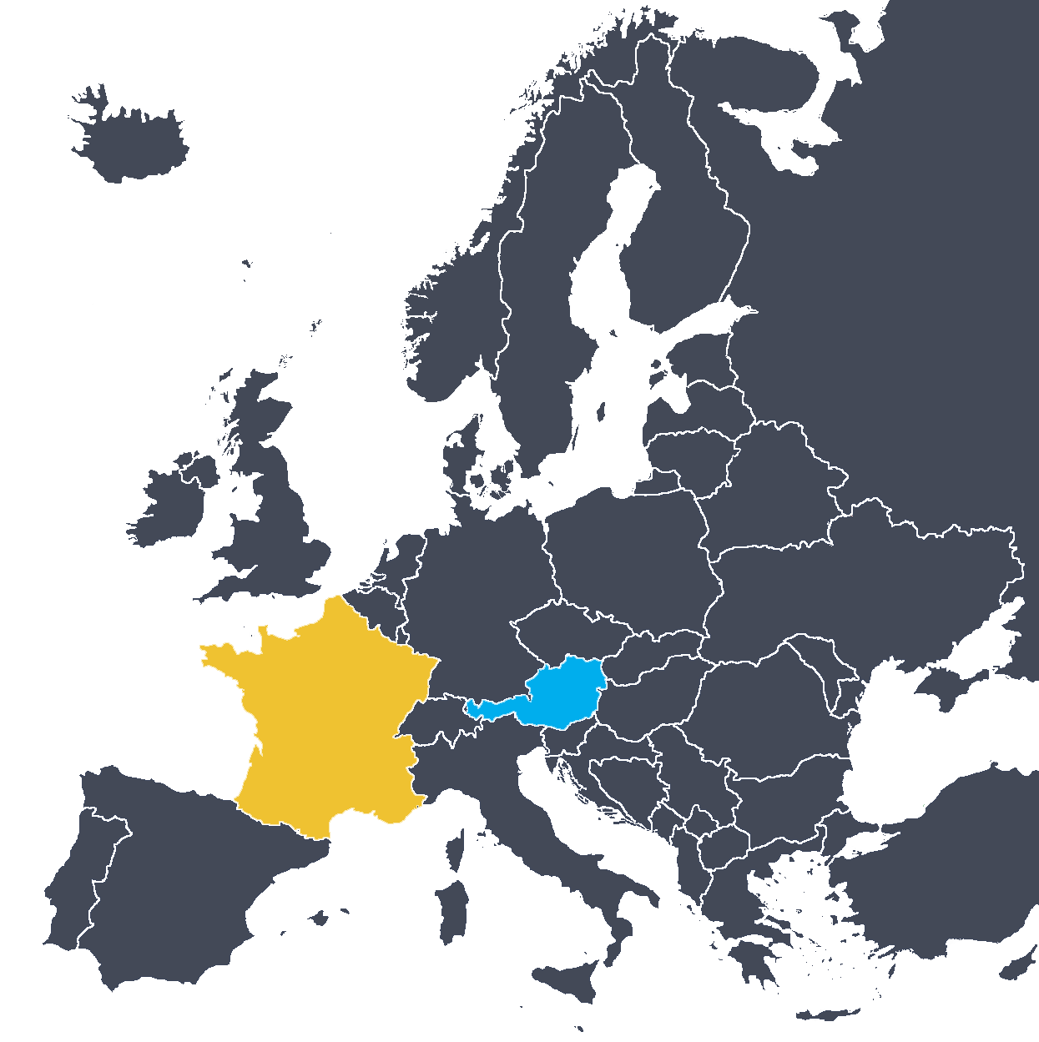
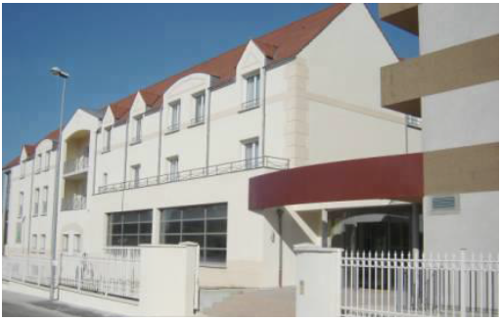
DEMONSTRATION
Demonstration of the integrated hybrid energy system will take place in two real buildings representative of different climate and
energy system configurations for 3 cases,
in Northern Europe (Austria) with and
without a heat grid, and in Middle/Southern
Europe (France) without a heat grid.
www.scores-project.eu

Slide 8
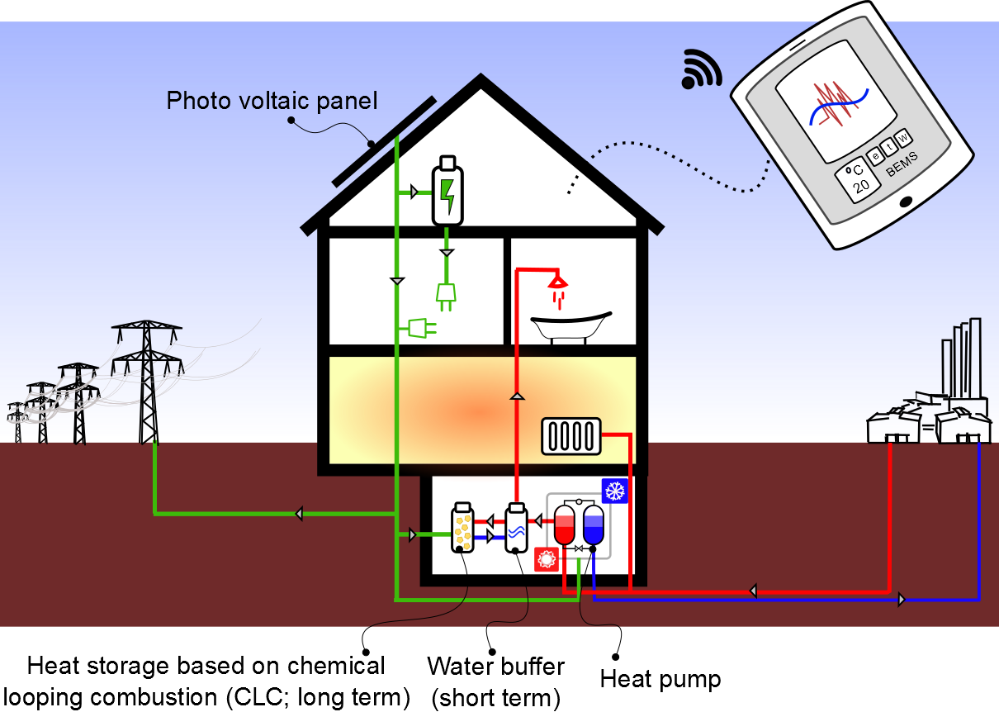
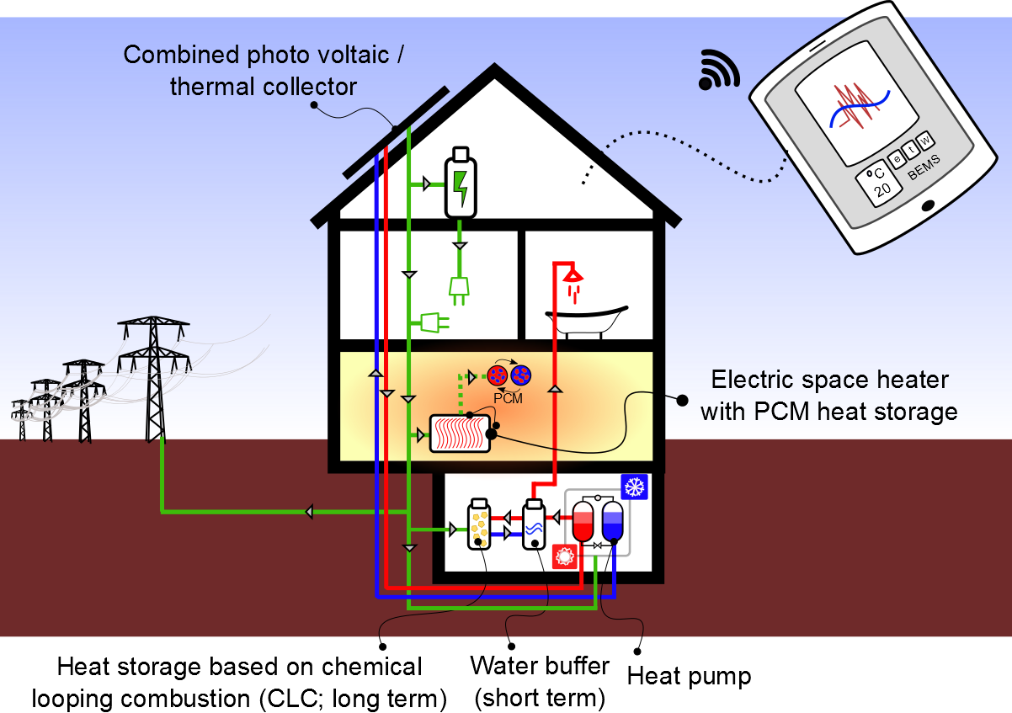
HYBRID SYSTEM CONCEPT
Configuration A
Configuration B
Connected to district heating grid:
Based on electric heating:
Demo in Austria
Demo in France
www.scores-project.eu

Slide 9











PARTNERS
INDUSTRY
Solar supply and energy conversion
Electrical and thermal storage
Building Energy Management System
Demonstration
Exploitation
RESEARCH
www.scores-project.eu

Slide 10
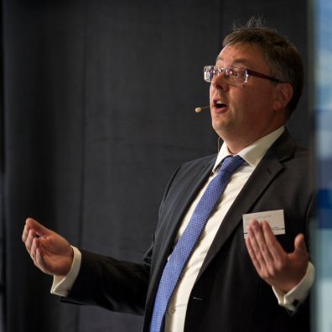


CONTACT INFO
For further project information please contact:
www.scores-project.eu
Ir. Christophe Hoegaerts
TNO
+31 (0)65 354 98 16
christophe.hoegaerts@tno.nl
Follow project latest news on social network profiles:
www.scores-project.eu

Slide 11
Self-Consumption Of Renewable
Energy by hybrid Storage systems
THANK YOU FOR ATTENTION!
Presenter name
Company
Email
The project leading to this application has received funding from the European Union’s Horizon 2020 research and innovation programme under grant agreement No 766464.

